Slide 1
DROWSINESS DETECTION SYSTEM

Slide 2
Table Of Contents
INTRODUCTION
DROWSINESS
OBJECTIVES
METHODOLOGY
RESULT
REFERENCES

Slide 3
INTRODUCTION
Now-a-days many of the people are suffering with less sleep due to work, stress, depression...etc. Especially the people who used to drive at nights are suffering with this problem. The lorry drivers, the tourism bus drivers who drives all over the day and night are not having proper sleeping patterns, this leads to lots of accidents. And drowsy driving affects the vehicles nearby, to avoid these problems we have created a drowsiness detection system which prevents the driver from dozing off. By this we can also prevent the traffics created by the accidents. This system is practically applicable in all 4 wheelers like cars, trucks, buses and greatly useful in large vehicles.

Slide 4
DROWSINESS
Drowsiness Sleep is the natural cyclical rest state of the body and mind. In this state, people often close their eyes and lose consciousness partially or completely. Drowsing can last for a few seconds, and during this time, the brain falls into a rapid and uncontrolled sleep, which can be extremely dangerous, especially in the case of driving or in situations demanding focused attention. There are some signs that show that drivers are not awake: yawning, blinking repeatedly and difficulty opening eyes, the inability to concentrate, the inability to keep the head straight, a distracted mind, feelings of tiredness, and blurred vision.

Slide 5
SURVEY REPORT
Lots of people dies on road accidents due to drowsiness and approximately 40% of deaths are caused due to drowsiness. In India over 21% of accidents were caused due to driver’s drowsiness. Around 1,47,000 people were killed in road accidents every year. The USA and Saudi Arabia reports most road accidents due to Drowsiness of the driver. More accidents happen by the Truck driver they are always forced to work overtime thus they had to sacrifice their sleep to get the job done. Approximately 28% of the truck drivers feel drowsiness while driving due to lack of sleep and driving lots of hours without a break, but they continue to ride to finish the job. Drowsing while drive doesn’t only harm us it also harms our surroundings; our nearby vehicle is affected by our carelessness.

Slide 6
OBJECTIVES
Road accidents are harder to prevent, and most of the accidents are caused due to drowsy driving. Our objective is to prevent the accidents that are caused by drowsiness.
Our main objectives in the project are:
To live capture the drivers eyes and calculate the eye aspect ratio(EAR) to detect whether the person is drowsing or not.
To alert the driver through a alarm if the calculated value is less than the value given in the program.

Slide 7
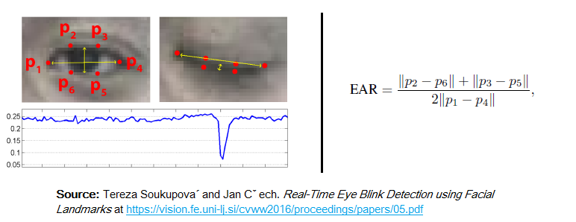
EAR formula:
Figure.1
The above figure shows how the EAR value is calculated and the 6 points scanning the eyes continuously.

Slide 8
METHODOLOGY
The model works with the help of OpenCV and Dlib Library. The Live camera video is fed into the program. The Face Recognition & OpenCV Library helps to mark the outline over the eyes and other necessary parts. The Face Recognition Library has an internal dataset that helps to mark the landmarks of the eyes. Our model requires only 6 Points to figure out. The video is looped for every frame and for every frame the eye outline is tracked continuously. Face Recognition library takes care of tracking the eye outline. That outline is marked as 6 points. When the points are marked the program proceeds to find the area between the points, the Euclid’s Distance formula has been used to find the distance between two opposite points to find the area. With the found distance we start to find the area between the points. The area is found using the special formula called EAR (eye aspect ratio). The camera records lively footage of the driver to calculate the lively responses of the driver

Slide 9
OPENCV: OpenCV is a cross-platform library that helps our model to amplify the input videos to the format in which the Face Recognition can plot the landmarks. When the video is looped for every frames OpenCV converts every image to grayscale so that Face Recognition can easily plot the landmarks, Normal color image is difficult to trace out hence it will be converted into a grayscale image. OpenCV is quick and very efficient. OpenCV doesn’t require a lot of system resources. Most functionalities of image processing are predefined with OpenCV.
DLIB: dlib is a toolkit for making real world machine learning and data analysis applications in C++. While the library is originally written in C++, it has good, easy to use Python bindings. It is majorly used for face detection and facial landmark detection. The frontal face detector in dlib works really well. It is simple and just works out of the box.

Slide 10
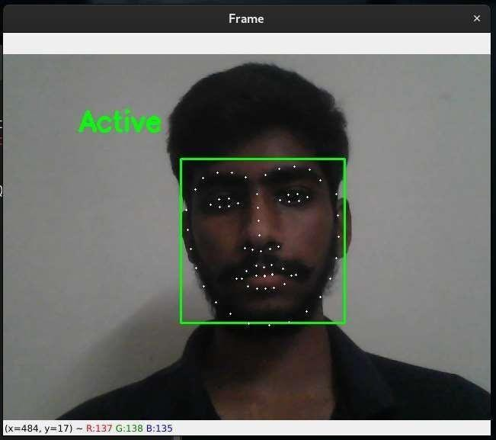
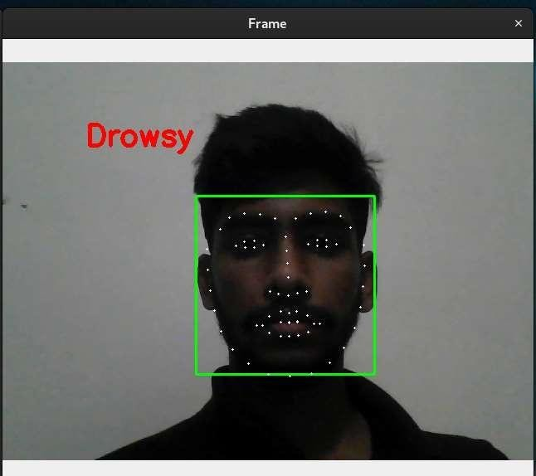
Our drowsiness detection model detecting the persons live status:
Figure.2
Figure.3

Slide 11
RESULT
As you can see from the Figures 2 and 3 the drowsiness detection system works perfectly. It works even the person is looking up or down and detects accurately. EAR formula is used in this project to detect the drowsiness of the person and this formula works with more accuracy. If the person closes his eyes for few seconds, it detects him as sleeping and alert the person with a alarm and notifies him to pull over. This drowsiness detection is feasible as it has less lines of code and the hardware requirements for the practical model is easy to access and available at low cost. If this drowsiness detection system is installed in all the 4 wheelers or trucks most of the accidents caused due to the drowsiness can be prevented and this drowsiness detection has greater accuracy than most existing models.

Slide 12
REFERENCES
[1] Jain M, Bhagerathi B, & C N, Dr S,(2021)real time drowsiness detection system using computer vision. International journal of engineering and advanced technology,(11)1, 109-113. https://doi.org/10.35940/ijeat.A3159.1011121
[2] An Application for Driver Drowsiness Identification based on Pupil Detection using IR Camera, Intelligent Human-Computer Interaction, pp 73-82, 2019
[3] T. Vesselenyi, S. Moca, A. Rus, T. Mitran and B. Tătaru, Driver drowsiness detection using ANN image processing, 2017.IOP conference series: materials science and engineering,(251). https://doi.org/10.1088/1757-899X/252/1/012097
[4] A. Kuwahara, K. Nishikawa, R. Hirakawa et al. cognitive robotics 2 (2022) 50-59
[5] Ngxande, M., Tapamo, J. R., & Burke, M. (2017). Driver drowsiness detection using behavioral measures and machine learning techniques: A review of state-of-art techniques. 2017 Pattern Recognition Association of South Africa and Robotics and Mechatronics International Conference, PRASA-RobMech 2017, 2018-January, 156–161. https://doi.org/10.1109/RoboMech.2017.8261140
[6] T. Soukupová , Eye Blink Detection Using Facial Landmarks Research Reports of CMP (5) (2016)

